Slide 1
First simulations with SHARC
Simulator for use in SHARing and Compatibility studies of wireless communication systems

Slide 2
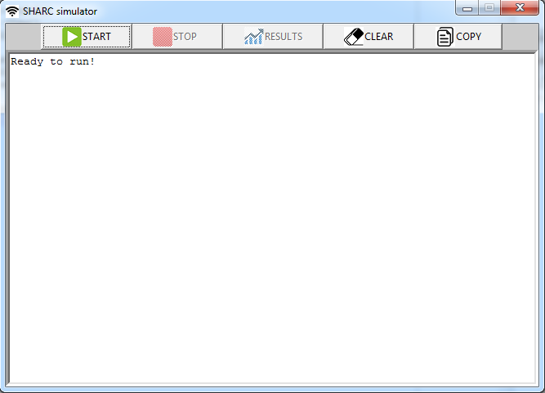
SHARC main window
Start simulation by clicking this button. Parameters can be found in parameters/ directory

Slide 3
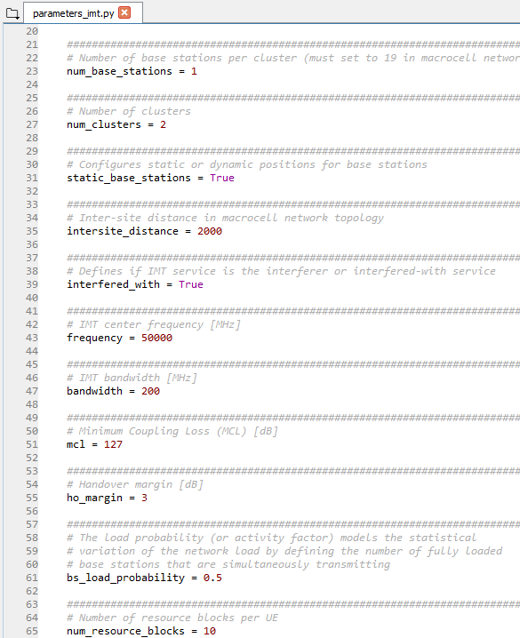
Parameters

Slide 4
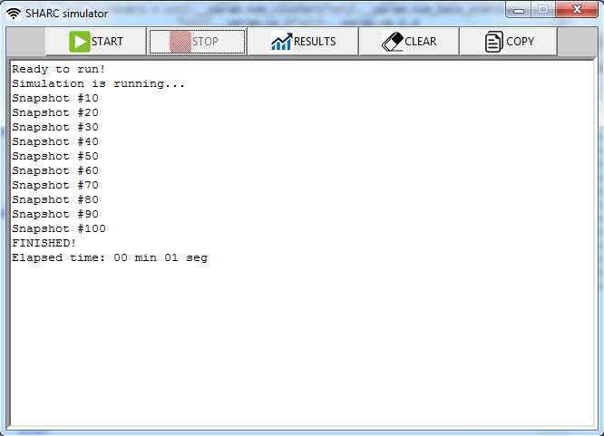
SHARC main window
Click this button to display results

Slide 5
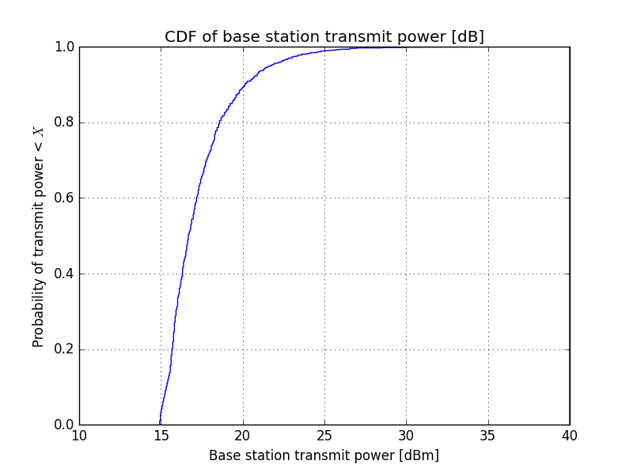
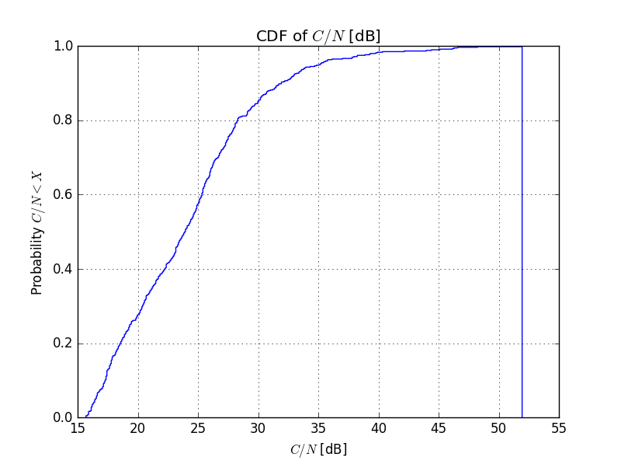
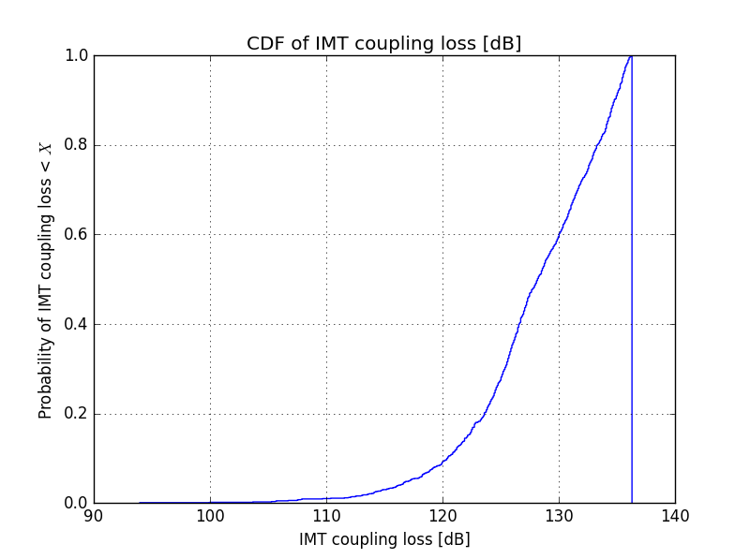
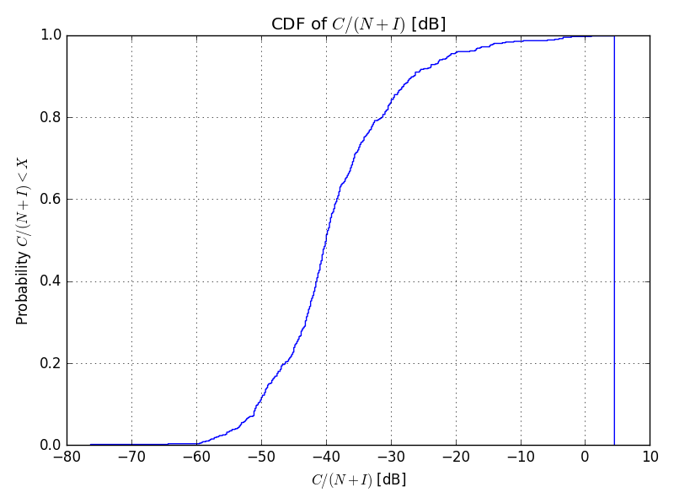
EXAMPLE

Slide 6
Simulation assumptions
IMT downlink only
Intra-system interference is taken into account
No interference from external sources
Omnidirectional antennas
No power control
Scheduler equaly divides resources among UE’s
Free space propagation model
UE randomly generated in simulation scenario
All generated EU’s are “chosen” (step 1.d)
No base station activity factor
Macrocell network topology without wrap around

Slide 7
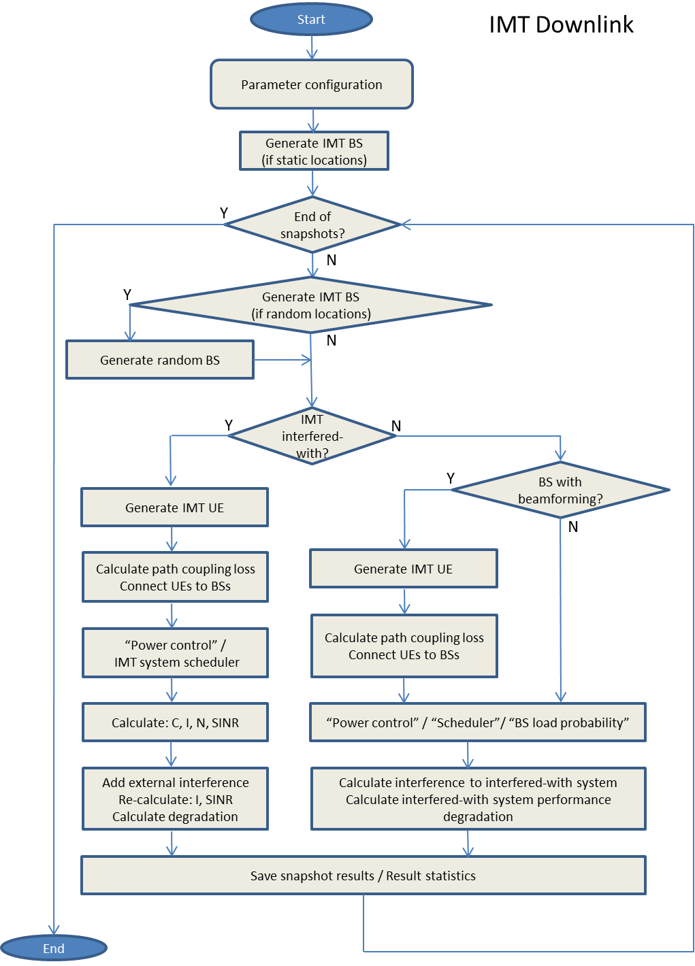
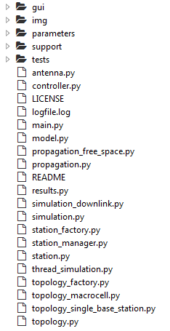
IMT downlink simulation method
classes to be created

Slide 8
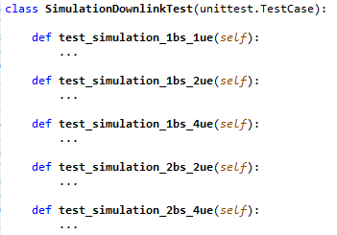
Testing a simulation snapshot
Unit tests of SimulationDownlink class create simulation snapshots

